Slide 1
HUMAN COMPUTER INTERACTION
Name: Ijlal Ahmad
Roll No: FL-21565

Slide 2
Amazon’s website adheres to the following principles

Slide 3
Match Between the System and the Real World
In amazon we have the labels like Today’s deals, Customer service, Registry , Gifts card Sell Carts and many more labels which when a customer see the customer knows that what the label is about.

Slide 4
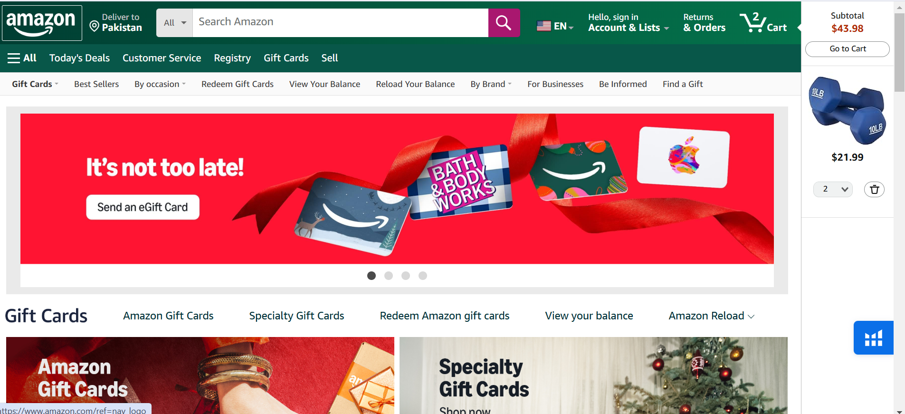
Consistency & standards
In Amazon, the main navigation bar, have the same options like (Today’s deals, Customer service, Registry , Gifts card, Sell, and Carts etc on every page of the amazon.

Slide 5
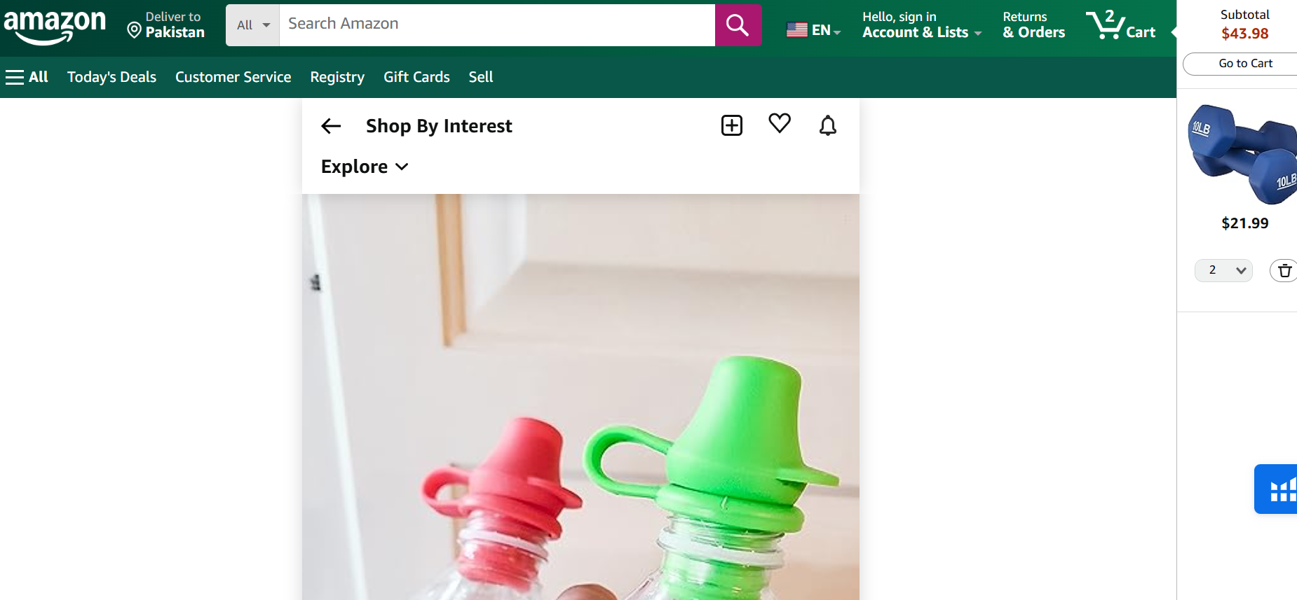
This is the page of when i select a product

Slide 6
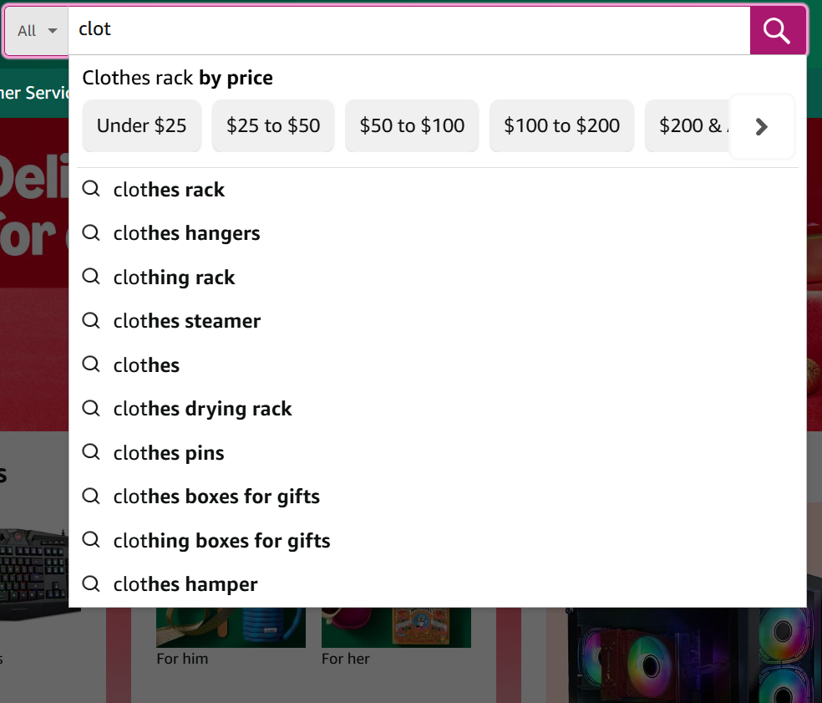
Recognition, not recall
In the search bar of amazon I typed just clo and it suggest me cloth rack, cloth hangers, clothing rack, clothes streamer etc automatically and I want clothes hanger so I just select it.

Slide 7
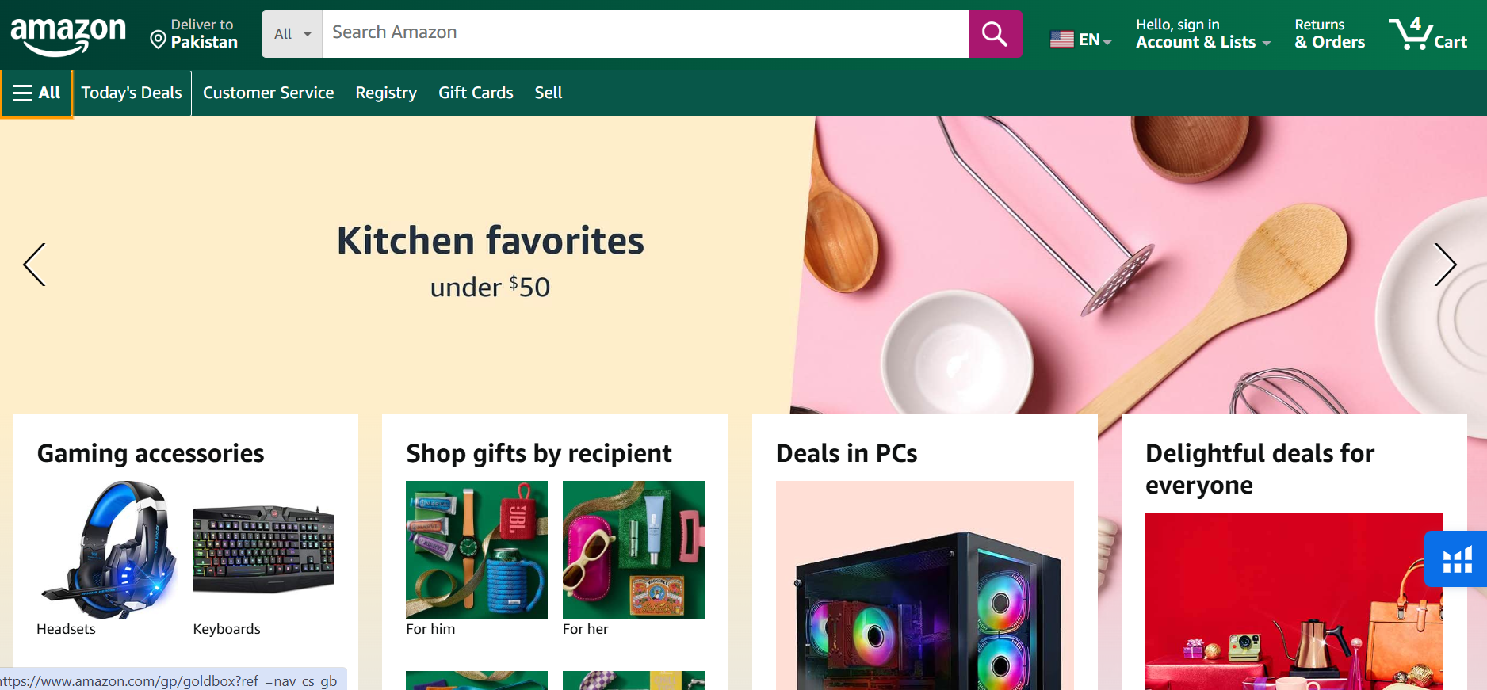
Aesthetic and minimalist design
Amazon have clear labels and categories with the help of which a customer clearly identifies that what to select which category to go.

Slide 8
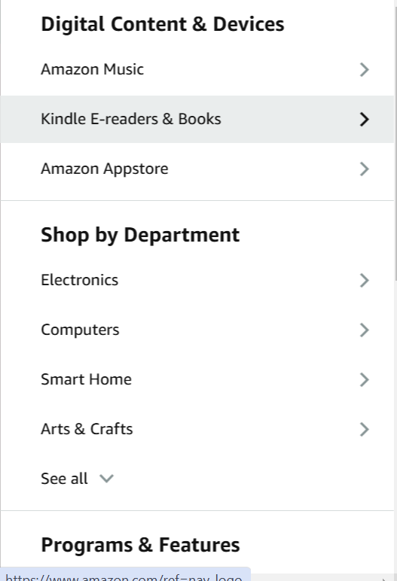
If a customer want a knife, the customer will not waste time on finding the knife, the customer will go in (Smart Home) Category.

Slide 9
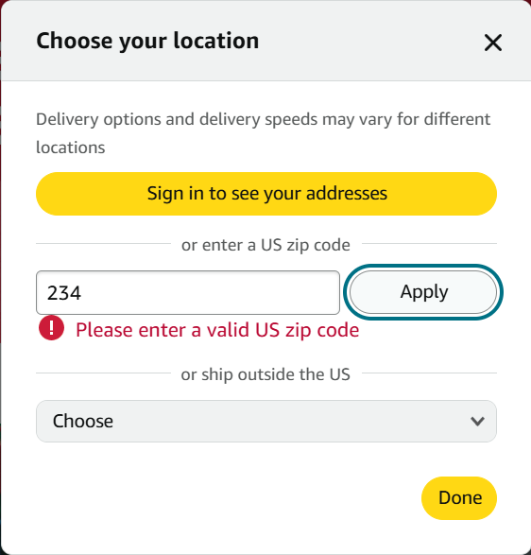
Error prevention
When an invalid information is added anywhere it gives an error message for correctness In amazon when I entered an invalid zip code it gives me a clear error message (Please enter a valid US zip code)

